Slide 1
Activation Energy, Temperature and Catalysts

Slide 2
In this lesson we are going to look at how to:
1. | Identify the effect of temperature on the rate of reaction.
2. | Identify the effect of catalysts on the rate of reaction.
3. | Explain what the activation energy of a reaction is.

Slide 3
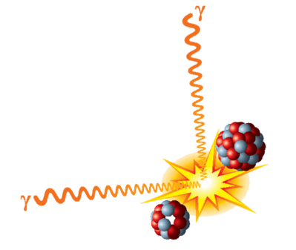
Why do reactants need a certain amount of energy to react when they collide?
This is the energy required to break the old chemical bonds, and form new ones!
This is known as the activation energy.

Slide 4

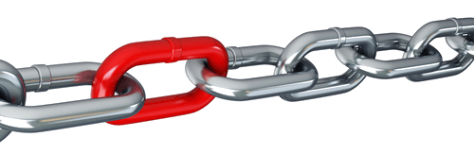
Consider the following reaction:
In order for this reaction to occur we need to first break the existing bonds in the hydrogen and chlorine molecules, and then form new bonds between the hydrogen and chlorine atoms.

Slide 5
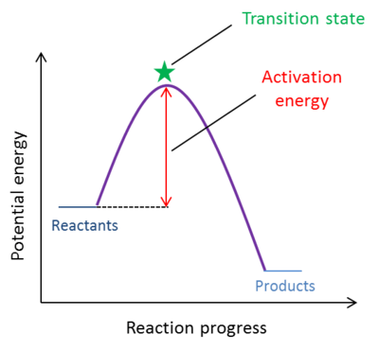
Activation energy can be shown using the following graph:
The peak of the graph is the transition state, which is the point of highest energy. If there is enough energy to cross this peak, the collision is effective.
Note that the activation energy is only the difference in energy between the reactants and the transition state. The energy of the products does not factor into it.

Slide 6
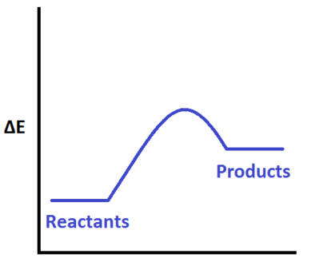
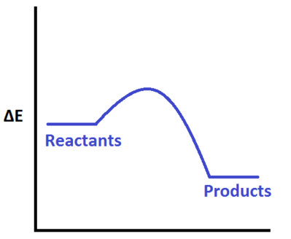
Whether the overall reaction gains energy (endothermic) or releases energy (exothermic), it still requires activation energy to occur!
Note how the reaction on the right releases more energy than it gains, however it still needed a bit of energy to get started.
Endothermic
Exothermic

Slide 7

Increasing the temperature will almost always increase the rate of reaction.
This happens because increasing the temperature causes the reactants to move faster.
Faster moving reactants means more collisions!

Slide 8
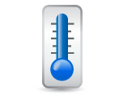
Decreasing the temperature will almost always decrease the rate of reaction.
This happens because decreasing the temperature causes the reactants to move slower.
Slower moving reactants means less collisions!

Slide 9
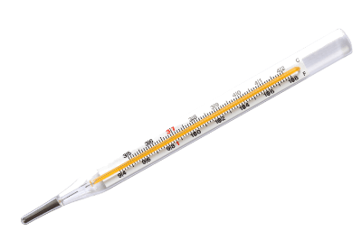
Additionally, the speed of the reactants determines how much energy they have.
Slowly moving reactants have less energy than quickly moving reactants.
This means that, in a collision, slowly moving reactants are less likely than quickly moving reactants to collide with enough energy.

Slide 10
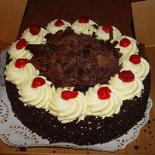
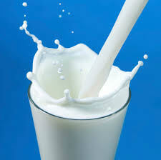
When you want to increase the speed of the reaction that cooks a cake, you would increase the temperature by turning the oven up!
When you want to decrease the speed of the reaction which turns milk sour, you would decrease the temperature by putting it in the fridge!
Both of these are examples of how we use temperature everyday to control the rate of reactions!

Slide 11
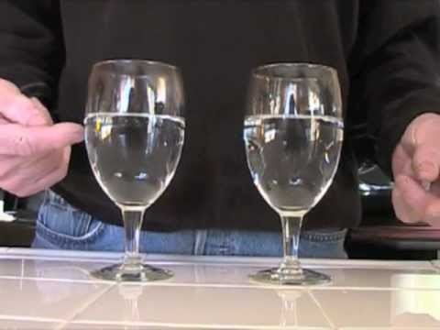

Slide 12
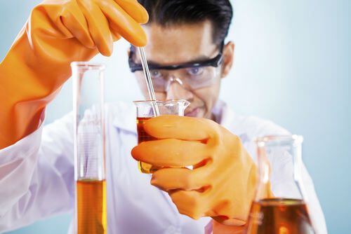
A catalyst is a chemical which speeds up a reaction, but is not consumed by the reaction.
In other words, the amount of catalyst you start with is the same amount you will end with, no matter what!

Slide 13
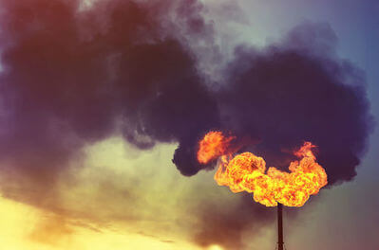
Catalysts can increase the rate of reaction in one of two ways:
1. | By making it easier for collisions to occur.
2. | By decreasing the energy a collision needs to be effective.

Slide 14
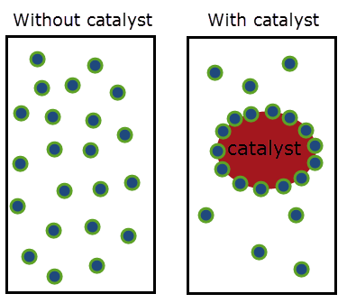
One way a catalyst makes it easier for collisions to occur by providing an ideal site for collisions to occur at.
As shown below, if all of the reactants move around the surface of a catalyst then they will collide more frequently because there is the same amount of reactants in a smaller volume!

Slide 15
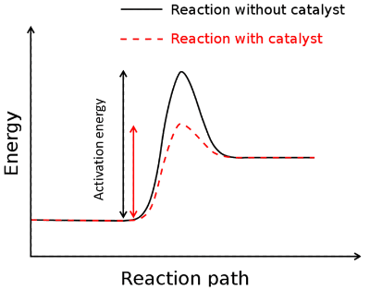
One of the ways a catalyst increases the rate of reaction is by effectively lowering the activation energy.
This is usually done by providing an alternative path to create the same products.

Slide 16
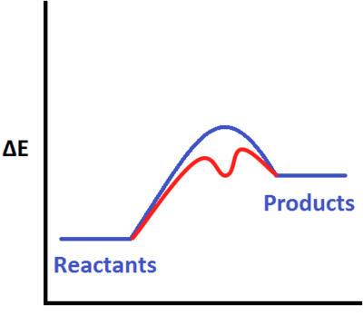
A catalyst can turn one high energy transition state into two or more lower energy transition states.
For example, the catalyst may split the bond-breaking and bond-forming steps into two collisions, each requiring lower energy than a single collision which breaks and forms bonds at the same time.

Slide 17
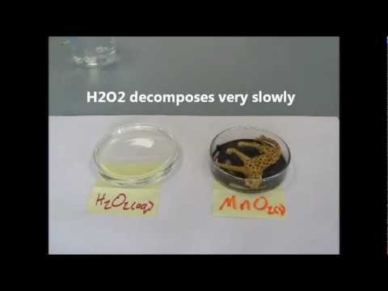

Slide 18
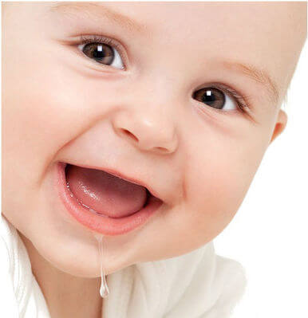
There's an example of a catalyst in your mouth right now: saliva!
Your body is full of biological catalysts called enzymes. The enzyme in your saliva is called amylase, and it speeds up the process of breaking down food.

